Slide 1
Capstone Project

Slide 2
CtrlShiftSpace
TEAM MEMBERS
Rajdeep Patel (ICT) (202301092)
Prince Sojitra (ICT) (202301126)
Dhruv Malani(ICT) (202301046)
Yogesh Bagotia (ICT) (202301114)

Slide 3
Problem :
P2. DEVELOPING A PLACEMENT MANAGER :
Develop a comprehensive Placement Manager system to streamline the placement process for the university. This system will record and manage all placement-related activities for each batch and program, including written tests, interviews, shortlisting, and job offers. Also, it can search for students placed in a specific company, batch-wise, location-wise, mean and median package, etc.

Slide 4
WHY WE USED “STRUCT” DATA TYPE ???
In our program "Placement Manager" we used "STRUCT" data type as the required datatype. This is because in this program we need to ask for inputs from the user about various info about the student, like name (which is string data type), student id (which is int data type) and much more. So as to combine all these data types for this student we have created a struct student.

Slide 5
Algorithm :
1. Include necessary header files.
2. Define a student struct with attributes for interview details.
3. Implement four functions: add_record, delete_record, display_record, and update_record.
4. In each function:
- Prompt the user for necessary inputs (company name, student ID, etc.).
- Open the corresponding CSV file or create it if it doesn't exist.
- Perform the required operation (add, delete, display, update) based on user input.
- Close the file after the operation

Slide 6
5. In the main function:
- Display a menu with options.
- Repeat until the user chooses to exit.
- Call the corresponding function based on the user's choice.
6. Exit the program when the user chooses to exit.

Slide 7
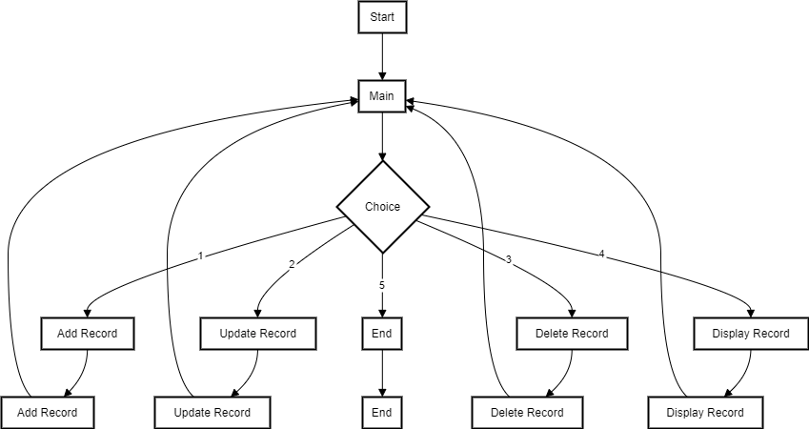
Diagramatic representation of algorithm :

Slide 8
Time complexity and space complexity :

Slide 9
Add a record
Talking about the “Time Complexity”, the add function has two operations, to input the record O(1) and to add it to the file O(n), where n is the number of records.
Therefore, the overall time complexity for the add function is O(n).
Now about the space complexity, only a constant amount of space is used for variables. Therefore overall space complexity for add function is O(1)

Slide 10
Delete a record :
The “Time Complexity” of delete function is O(n) As it needs to write n-1 records to the new file, and then rename it.
And the space complexity for is O(1) as a constant amount of same is required as in the add function.
Therefore, overall time complexity for delete function is O(1).

Slide 11
Display a record :
The “Time Complexity” of display function is O(n) As it needs to traverse through n records to reach nth record.
And the space complexity is O(1) as a constant amount of the space is required.
Therefore, overall time complexity for display function is O(1).

Slide 12
Update a record :
The “Time Complexity” of update function is O(n)
And the space complexity is O(1) as a constant amount of the space is required.
Therefore, the overall time complexity for the update function is O(1).

Slide 13
Recording of running code with voice over :
Link :
https://drive.google.com/drive/folders/1bHHNe8opoUwo2m0aHzbVhEKL1C3pIFDj?usp=sharing

Slide 14
THANK YOU

